Slide 1
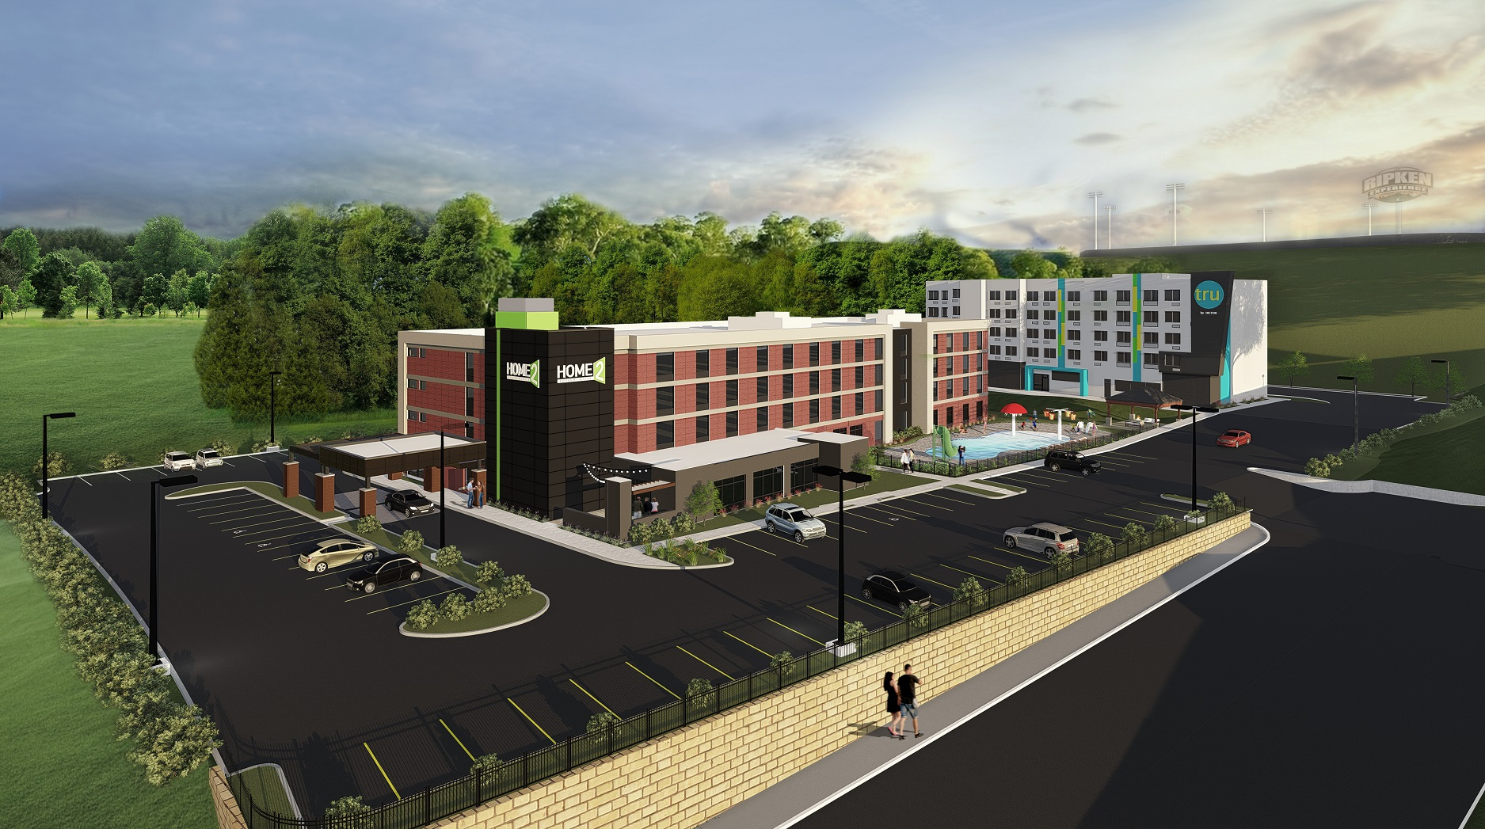
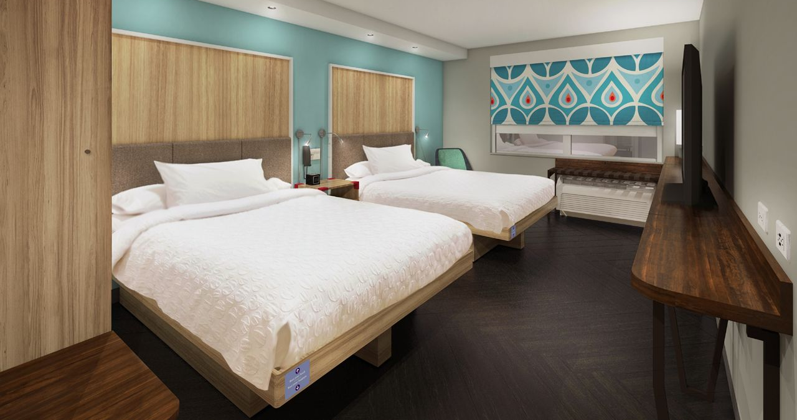
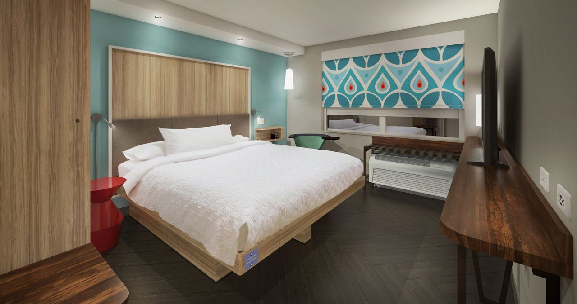
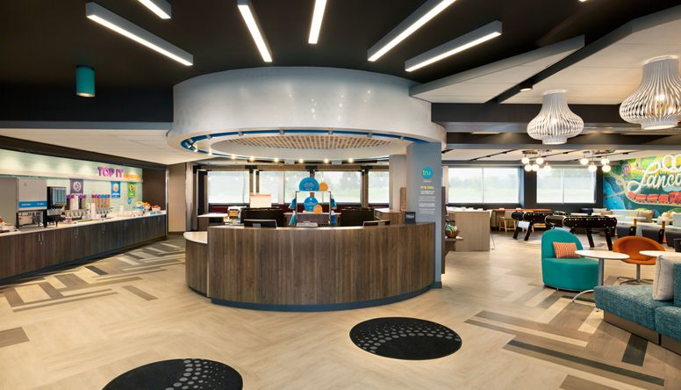
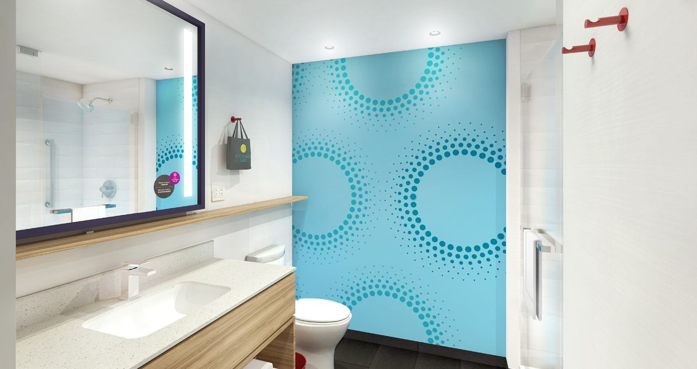
HOTEL 6 – TRU Hotel TRU Hotel & Home2 are next to each other
Newest Hotel in Pigeon Forge – Opened June 2018
Four zone lobby, offering the perfect spot to play, relax and eat.
24/7 Market - Eat. & Sip for snacks, beverages and single-serve wine and beer
Rooftop lounge
Pool Tables in the lobby
Semi-private alcoves in lobby are the perfect spot to for some quiet time
Guestrooms have hardwood-like floors
Spacious bathroom
55-inch HDTV
All-white bedding on a king-sized or double beds Serta mattress
Glass-door shower
Mini-Refrigerator & microwaves in all guestrooms
Complimentary gourmet coffee, tea and hot chocolate are available in the lobby 24/7.
HDTV Flat Screen TVs with Cable
FREE High-Speed Wireless Internet Access
24 Hour Fitness Center
Business Center
Indoor Heated Pool
WSF Event held at this property
Guest staying at this property will be charged a $250 credit or debit card authorization fee at check in. This will cover any damages done to the room. If there are no damages to your room during your stay, after check out your $250 authorization fee will be released. This is non-negotiable and will be applied to each room, not each individual in the room.

