Slide 1
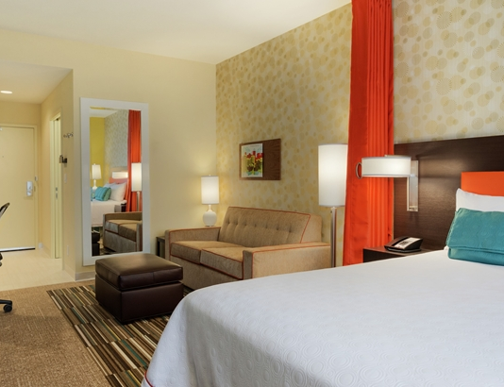
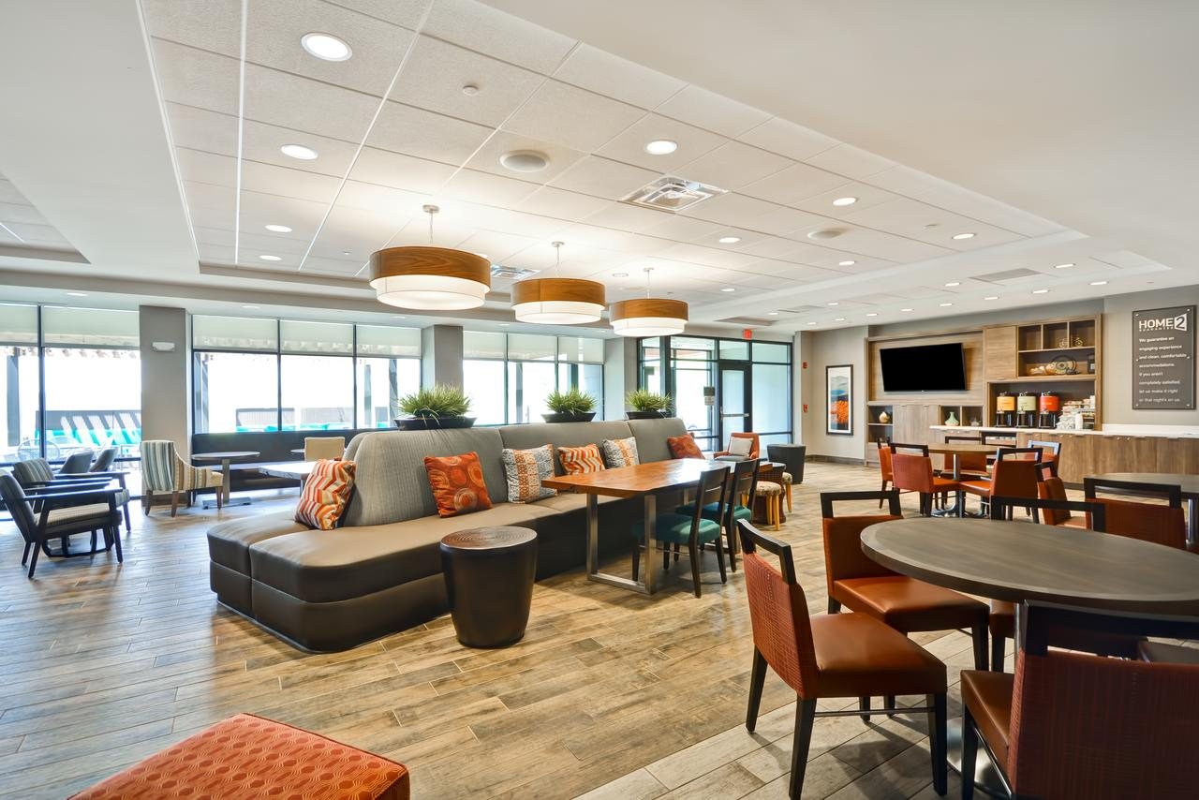
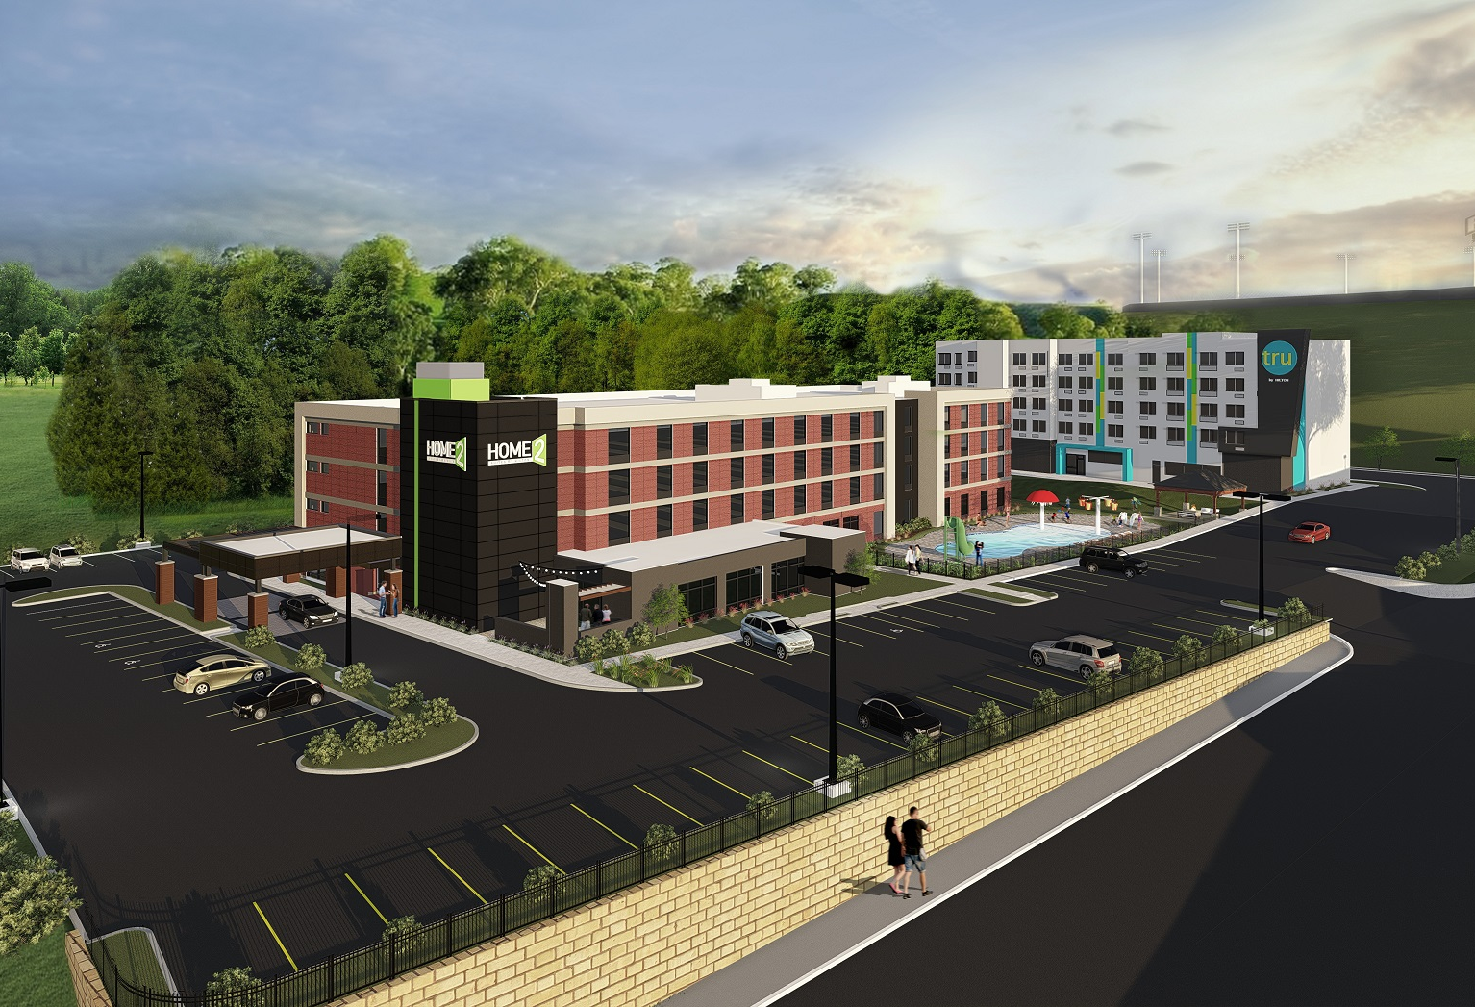
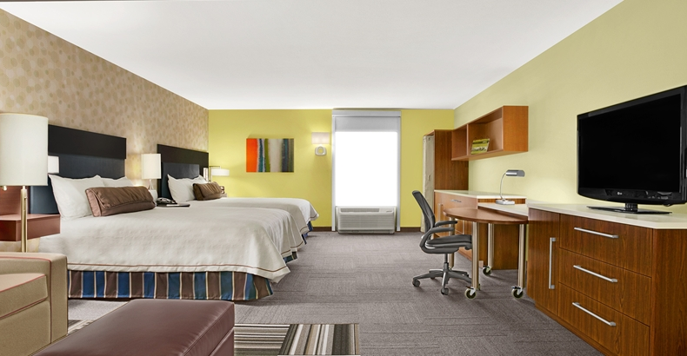
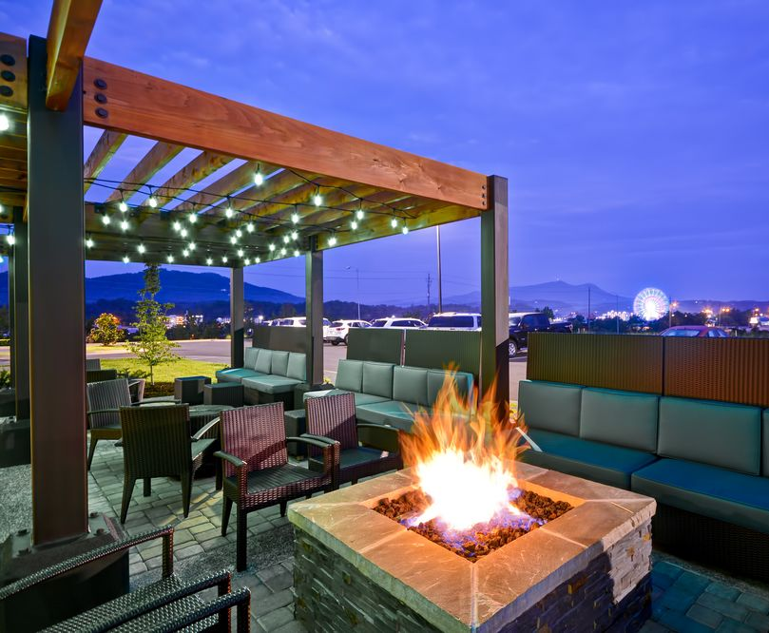
ALL SUITES & KITCHENS IN EVERY ROOM New Hotel in Pigeon Forge – Opened May 2017 King Size Bed (Serta Suite Dreams) Studio Suite with Queen Size Pullout Sofa Bed & Work Area OR Double Queen Size Beds (Serta Suite Dreams) Studio Suite with Living Area & Work Area Spacious Suites HDTV Flat Screen TVs with Cable FREE High-Speed Wireless Internet Access Fitness Center Paddle Tennis Table Business Center Indoor Heated Pool The kitchen area includes a refrigerator, microwave oven dishwasher, flatware, microwavable cookware, coffeemaker and toaster. Induction burner cooktops are also available free from the front desk. Guest staying at this property will be charged a $150 credit or debit card authorization fee at check in. This will cover any cooking or smoke damages done to the room. If there are no damages to your room during your stay, after check out your $150 authorization fee will be released. This is non-negotiable and will be applied to each room, not each individual in the room. WSF Event held next to this property
Hotel 4 – Home2

